Slide 1
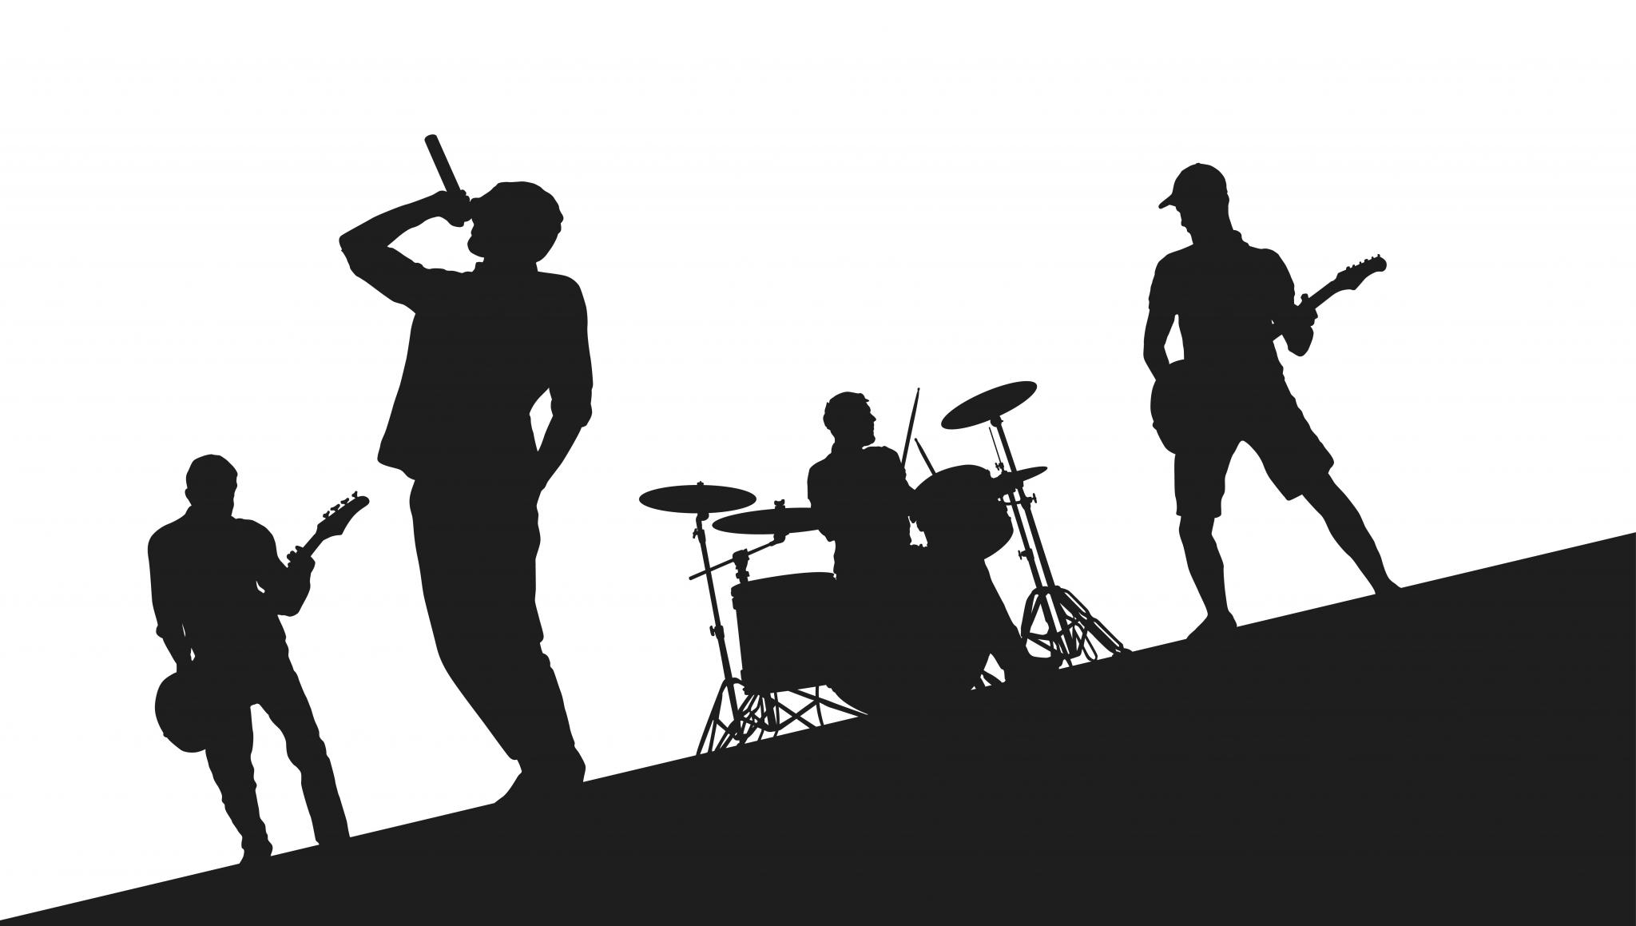
The Birth of a Chartbuster
Anisha Alluru
Khyathi Balusu
Manas Rai
Ravi Kiran Bobba
Vishal Ramachandran

Slide 2
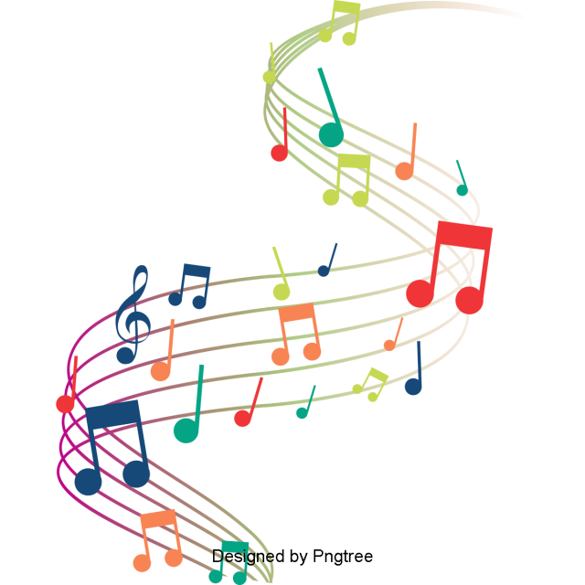
AGENDA
Project Objective
Data Collection
Exploratory Data Analysis
  Topic Modeling and Sentiment Analysis
  Modeling - Regression and Classification
Song Recommendation Engine
  Key Takeaways

Slide 3

OBJECTIVE
Leverage our web scraping, modeling and text analysis skills to the best possible use and come up with a business product that would:
Predict if a song would become a hit based on its lyrics and musical features
Suggest the right ingredients for a banger hit
Perform content based song recommendation

Slide 4
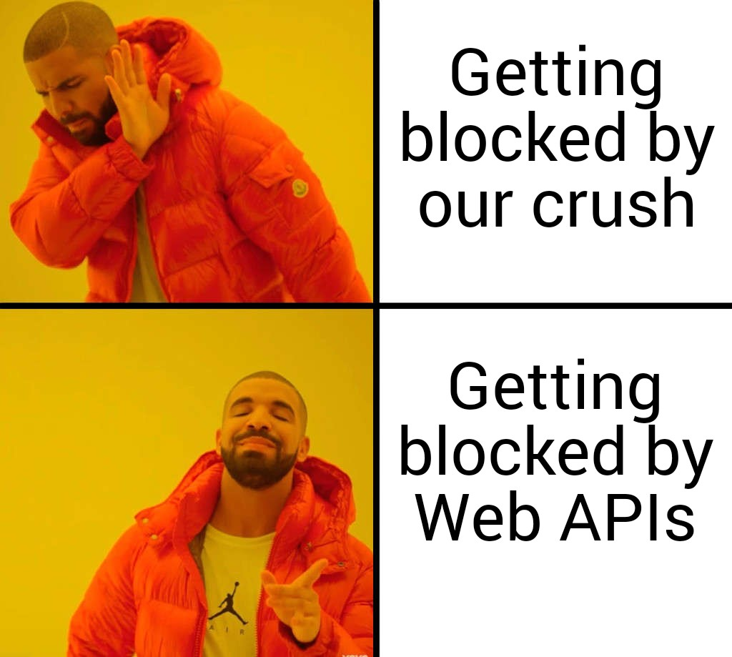

Slide 5




SERIAL SCRAPING
SONG FEATURES
LISTENER COUNT
LYRICS

Slide 6
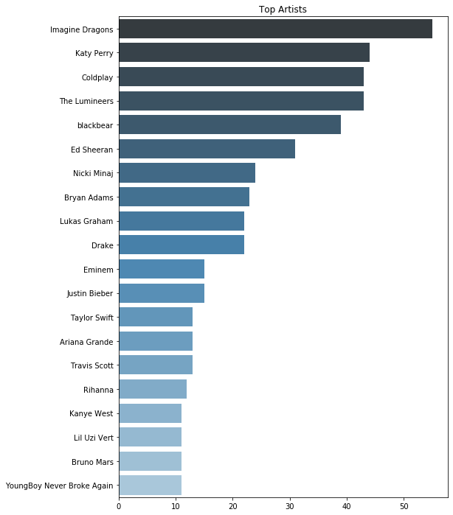
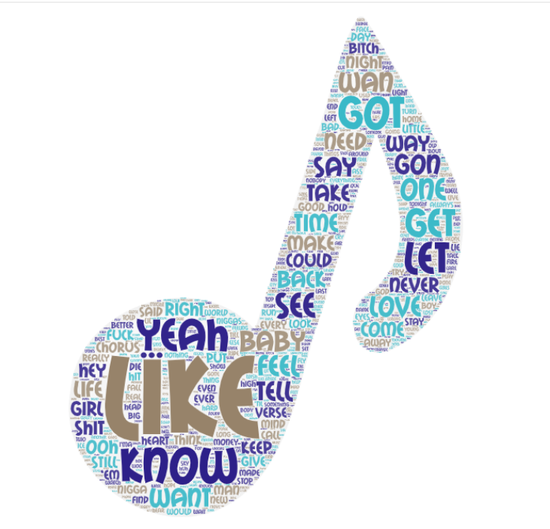
DATA OVERVIEW
Most Frequent Words

Slide 7
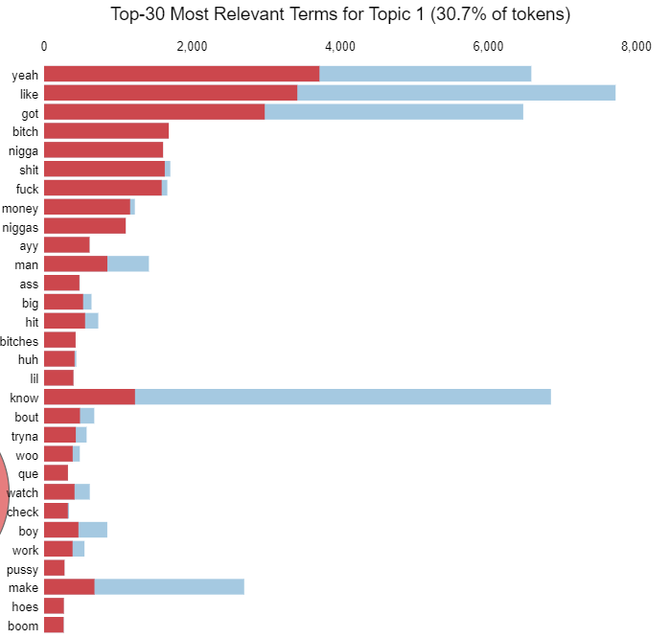
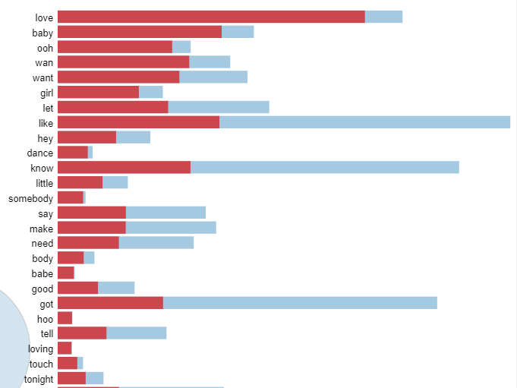
TOPIC MODELING
Topic 1: Explicit
Topic 2: Love/Emotional
Bitch Better Have My Money
Run the World (Girls)
Truth Hurts
Faded - Alan Walker
Hello - Adele
Angela - The Lumineers

Slide 8
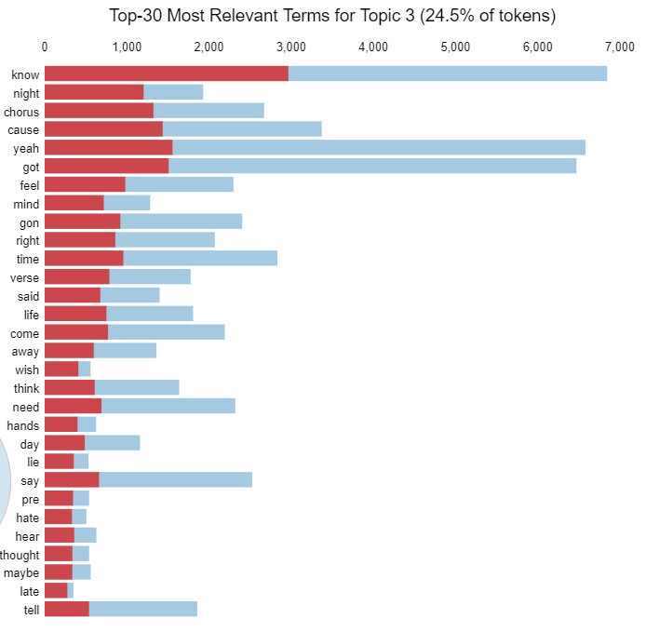
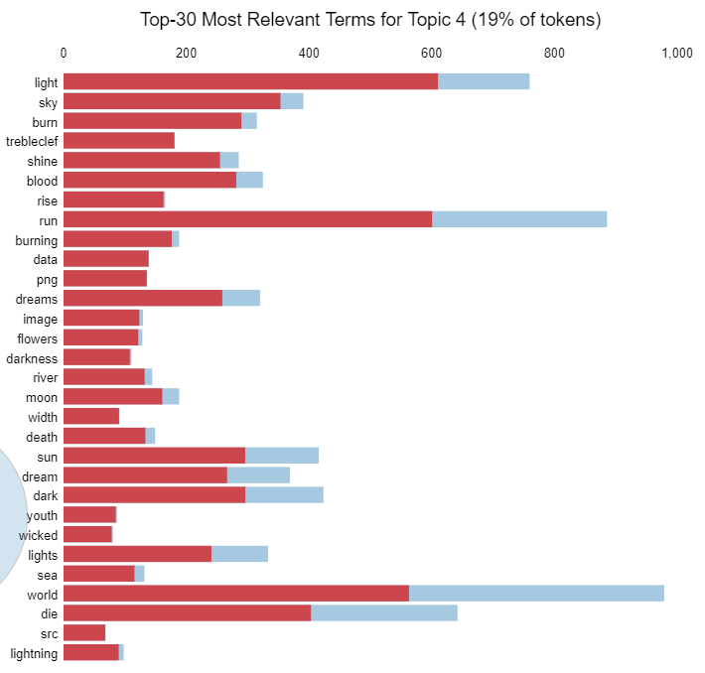
TOPIC MODELING
Topic 3: Reflective/Upbeat
Topic 4: Breakfree/Celebrating Yourself
Call Me Maybe
Shape of You
24K Magic
Shake It Off
Bang Bang
FRIENDS

Slide 9
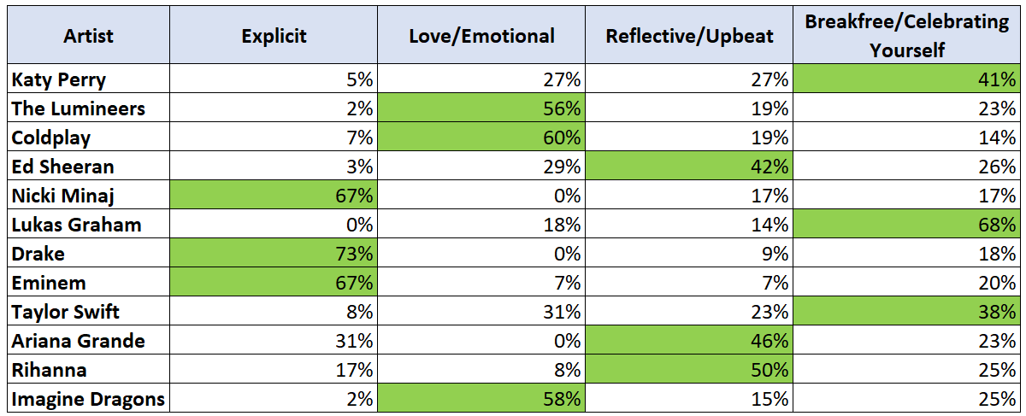
TOPICS AND TOP ARTISTS

Slide 10
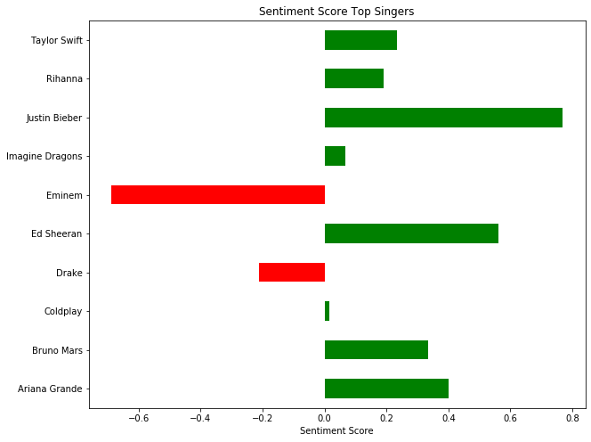
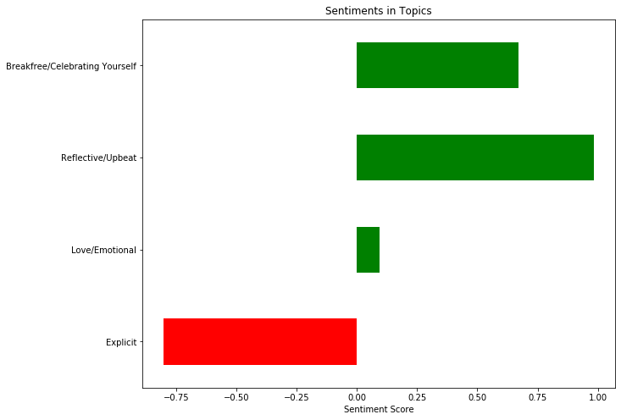
SENTIMENT ANALYSIS

Slide 11
Predictive Modeling

Slide 12
MODELING - CLASSIFICATION
Hypothesis:
Can Text Analysis Techniques like Topic Modelling, Predicting Sentiment, TF-IDF help in improving Prediction of Hit ?
Approach:
Created a base model with different features of the song and then incorporated different metrics based on text analysis of Lyrics of the song into the model
Results:
Actual | Predicted
 | Miss | Hit
Miss | 476 | 14
Hit | 208 | 17
Actual | Predicted
 | Miss | Hit
Miss | 472 | 18
Hit | 192 | 33
94% Percent higher prediction in number of Hits compared to baseline Model with features of the song, with a slight improvement in accuracy (69% to 71%)

Slide 13
MODELING - REGRESSION
Hypothesis:
Can Text Analysis Techniques, help in prediction of number of Views ? How much additional variation in number of views can be explained using Text ?
Approach:
Created a base model with different features of the song and then incorporated different metrics based on text analysis of Lyrics of the song into the model
Results:
10% Higher explanation in Variation in number of views using Text Analytics
R² Value | Model using Song Features | Model using Topic Modeling and Sentiment
 | 0.66 | 0.74

Slide 14
Recommendations

Slide 15
RECOMMENDATION METHODOLOGY
Hypothesis:
Can Text Analysis help in improving the Recommendations of Songs ?
Approach:
Model 1
  Based on Song Features like Danceability, Loudness, etc
Model 2
  Based on TF-IDF on Lyrics
Model 3
  Based on Song Features, TF-IDF, Sentiment and Topic Modelling

Slide 16

SONG RECOMMENDATION - 1
Model 1 (Features of Song) |  | Model 2 (TF-IDF) |  | Model 3 (Features, TF-IDF, Topic Modelling, Sentiment)
Song | Artist | Song | Artist | Song | Artist
Bibia Be Ye Ye | Ed Sheeran | Me and Your Mama | Childish Gambino | Peacock | Katy Perry
Written in the Sand | Old Dominion | CoCo | O.T. Genasis | Mad Love | Mabel
Drown | Clairo | I Think I'm In Love | Kat Dahlia | Treasure | Bruno Mars
Englishman In New York | Sting | Can't Feel My Face | The Weeknd | What Do You Mean? | Justin Bieber
What Do You Mean? | Justin Bieber | Nothin to Somethin | Syd | Happy | Pharrell William

Slide 17
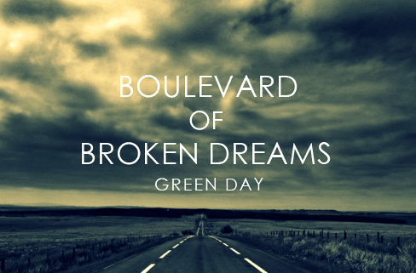
SONG RECOMMENDATION - 2
Model 1 (Features of Song) |  | Model 2 (TF-IDF) |  | Model 3 (Features, TF-IDF, Topic Modelling, Sentiment)
Song | Artist | Song | Artist | Song | Artist
Heartbeat Song | Kelly Clarkson | Walk Thru (feat. Problem) | Rich Homie Quan | Uma Thurman | Fall Out Boy
In The Night | The Weeknd | Eyes Wide Open | Gotye | Exits | Foals
For the First Time | The Script | Your Own | SALES | Maps | Maroon 5
Blinding Lights | The Weeknd | My Heart Stood Still (Remastered) | Peggy Lee | Not Afraid | Eminem
Found You | Kane Brown | Boom Boom | John Lee Hooker | My Songs Know What You Did In The Dark | Fall Out Boy

Slide 18
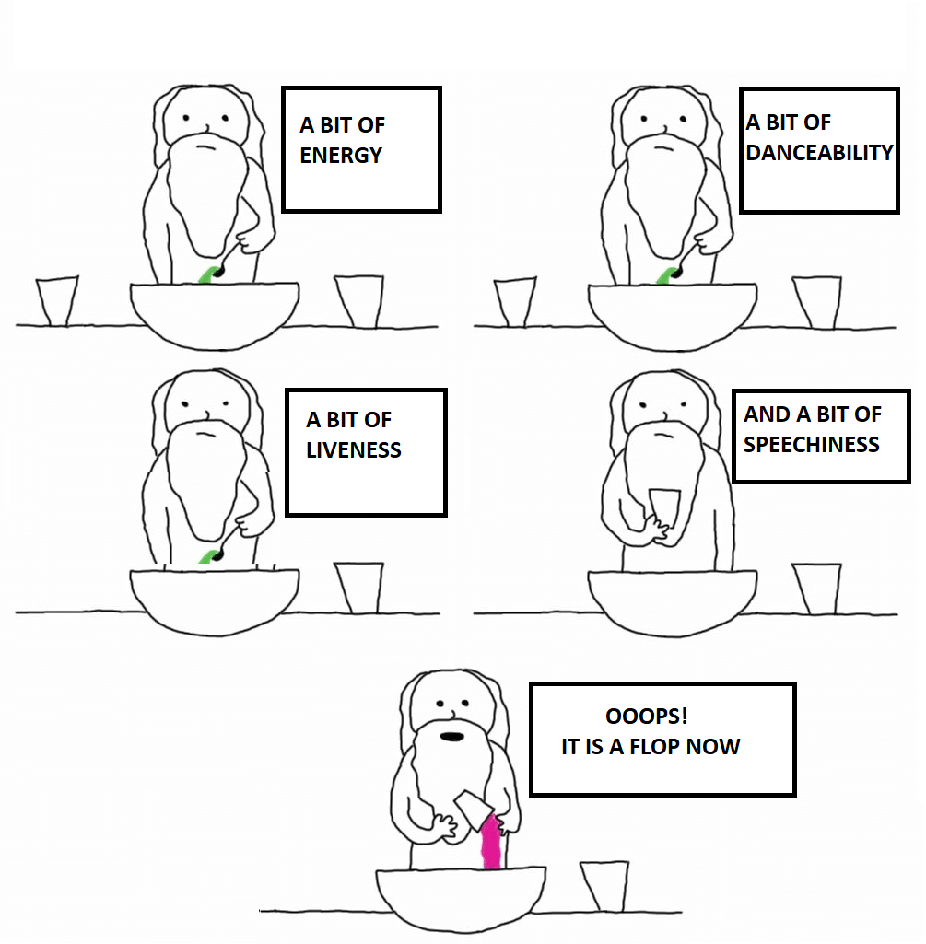
WHEN THE ARTIST WAS MAKING A BREAK-FREE SONG

Slide 19
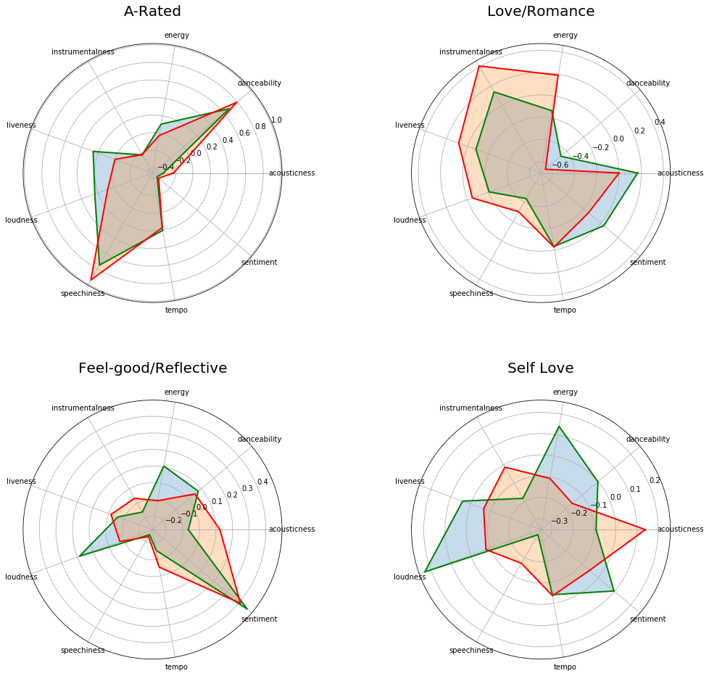
THE RIGHT INGREDIENTS!
Explicit
Love/Emotional
Liveliness & Energy | Acousticness & Sentiment
Speechiness & Danceability | Instrumentalness & Energy
Notes:
Explicit: Goosebumps by Travis Scott, No Frauds by Drake
Love: Better Now Post Malone, Perfect, Ed Sheeran

Slide 20
THE RIGHT INGREDIENTS!
Reflective/Upbeat
Breakfree/Celebrating Yourself
Loudness & Energy | Loudness & Energy
Acousticness | Instrumentalness & Acousticness
Notes:
Upbeat: Shape of you, Bloodline by Ariana Grande
Breakfree: Deep Six, Marilyn Mason, Gorgeous by Taylor Swift

Slide 21
RECIPE!
If you are planning to go pro making music, ditching the MSBA course, maybe you could try our recommendation recipe for a song?
Let us consider the breakfree Topic,
For this Topic,
A healthy portion of loudness
Generous serving of energy
A pinch of sentiment to taste
Avoid acousticness and instrumentalness, for the dish to come out in the best possible way!
Tada, your instant chartbuster is served piping hot!

Slide 22
Business Application
Content Based Recommendation of audio songs may not be as effective in Recommendation compared to Collaborative Recommendation; However it can be applied in following use cases.
Launch of Upcoming Artists to identify the songs/Topics where marketing efforts for the launch should be directed
Ad placement based on recommendations can be effectively handled
Also,
These ingredients can be potential blockbuster material for budding artists vying for billboards/chartbusters

Slide 23


QUESTIONS?

Slide 24
APPENDIX?

Slide 25
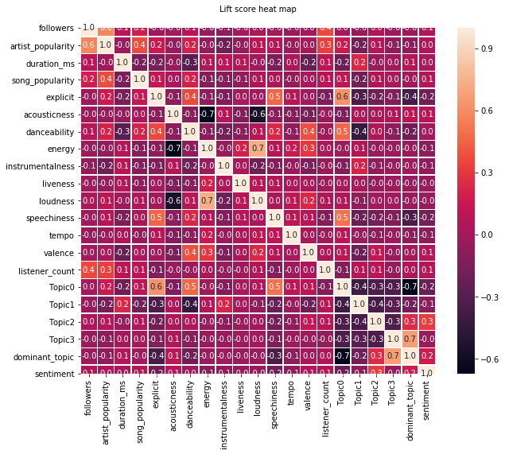
Explicit songs are more verbose and high on energy

